Slide 1
FILES & FILE HANDLING

Slide 2

SESSION TOPICS:
what is a file ?
What is File handling ?
File methods
Different Modes
File Processing using methods
Use of ‘with’ statement

Slide 3
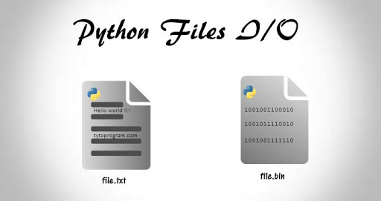
WHAT IS A FILE ?
File is a named location on disk used to store related
information
Python has several functions for creating, reading,
updating, and deleting files.

Slide 4
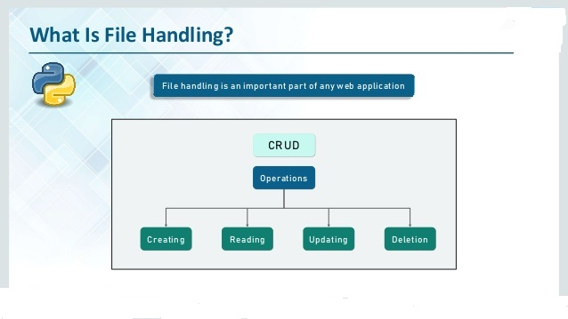
WHAT IS FILE HANDLING ?
Python too supports file handling and allows users to handle files i.e., to read and write files, along with many other file handling options, to operate on files.

Slide 5
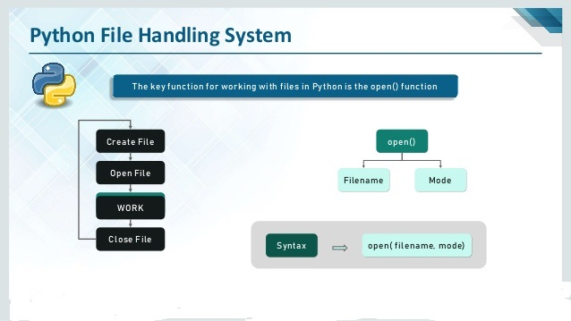
METHODS IN FILES
we have few methods in files to handle with files.

Slide 6
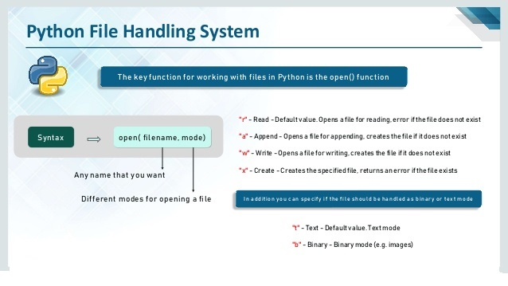
DIFFERENT TYPES OF MODES

Slide 7
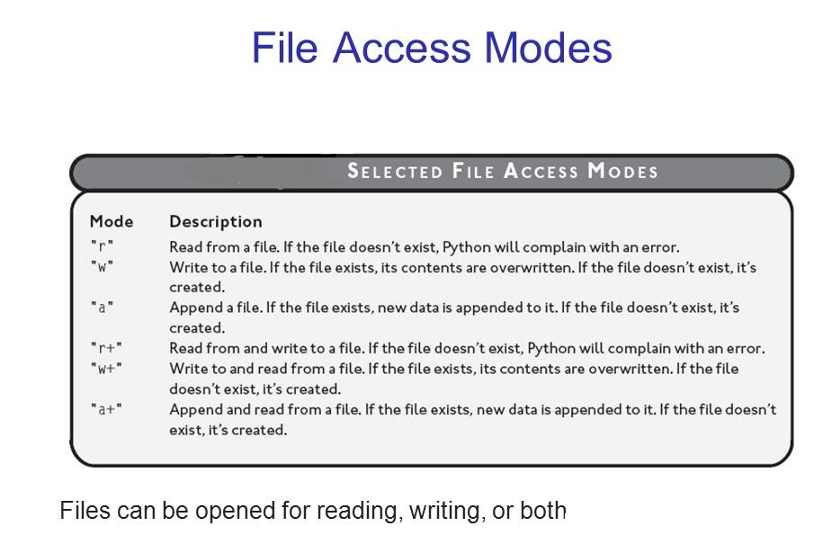
CONTI…

Slide 8
CONTI…
Opening Files : Python has a built-in open() function to open a file. This functions returns a file object, also called a handle.
We can specify the mode while opening a file.
The default is reading in text mode.
Syntax: file_obj = open(“filename.txt”,”mode(r,w,a)”)

Slide 9
CONTI…
Closing a File : When we are done with file handling on the file, then we need to close the file.
It is done by using the close() method available in python.
But this method is not safe.
Syntax: file_obj.close()

Slide 10
USE OF ‘WITH’ STATEMENT
The best wat to close a file by using the with statement.
This ensures that the file is closed when the block inside the with statement is exited.
Syntax: with open(‘filename.txt’,’’mode’) as file_obj:

Slide 11
CONTI…
Writing to a File : In order to write into a file , we need to open it in write mode or append mode.
While we use these two modes if file exist then it writes if it does not exist then it will create a new file with a given name.
Syntax: with open(“filename.txt”,””mode”) as file_obj:
statements..

Slide 12
CONTI…
Reading Files : To read a file we must open the file in reading mode.
We can use the read(size) method to read in particular size of data.
Syntax: f.read() 🡪 read till end of the file
f.read(6) 🡪 read the first 6 data

Slide 13

Difference between append and write ?

Slide 14
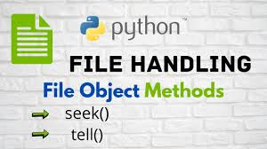
CONTI…
We have two different file object methods:
1) seek() : to change cursor position
2) tell() : to know the cursor position

Slide 15
TASKS
Write a Python program to print the size of a file.
Write a Python program that displays the longest word found in a text file.
Write a function in python that allows you to count the frequency of repetition of each word found in a given file.using dictionaries.
Write a Python program that allows you to group in a list the words common for two text files: file1.txt and file2.txt.
Write a program to count the character frequency, All the characters occurences.

Slide 16


